Slide 1
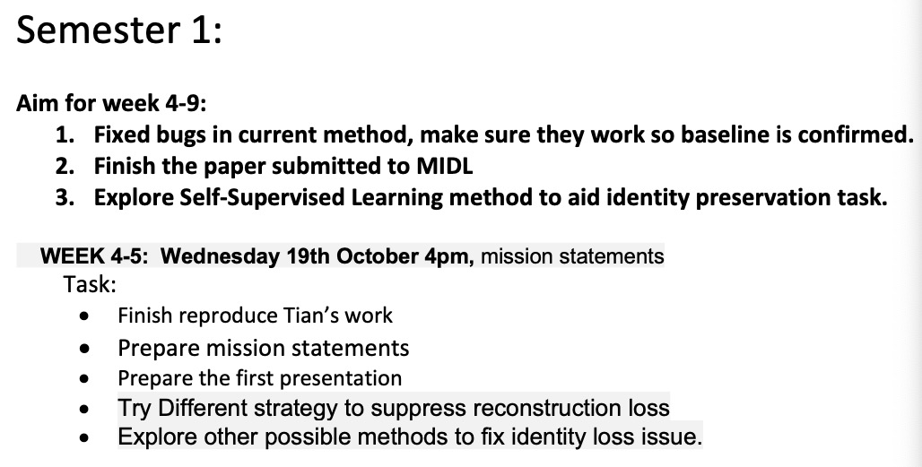
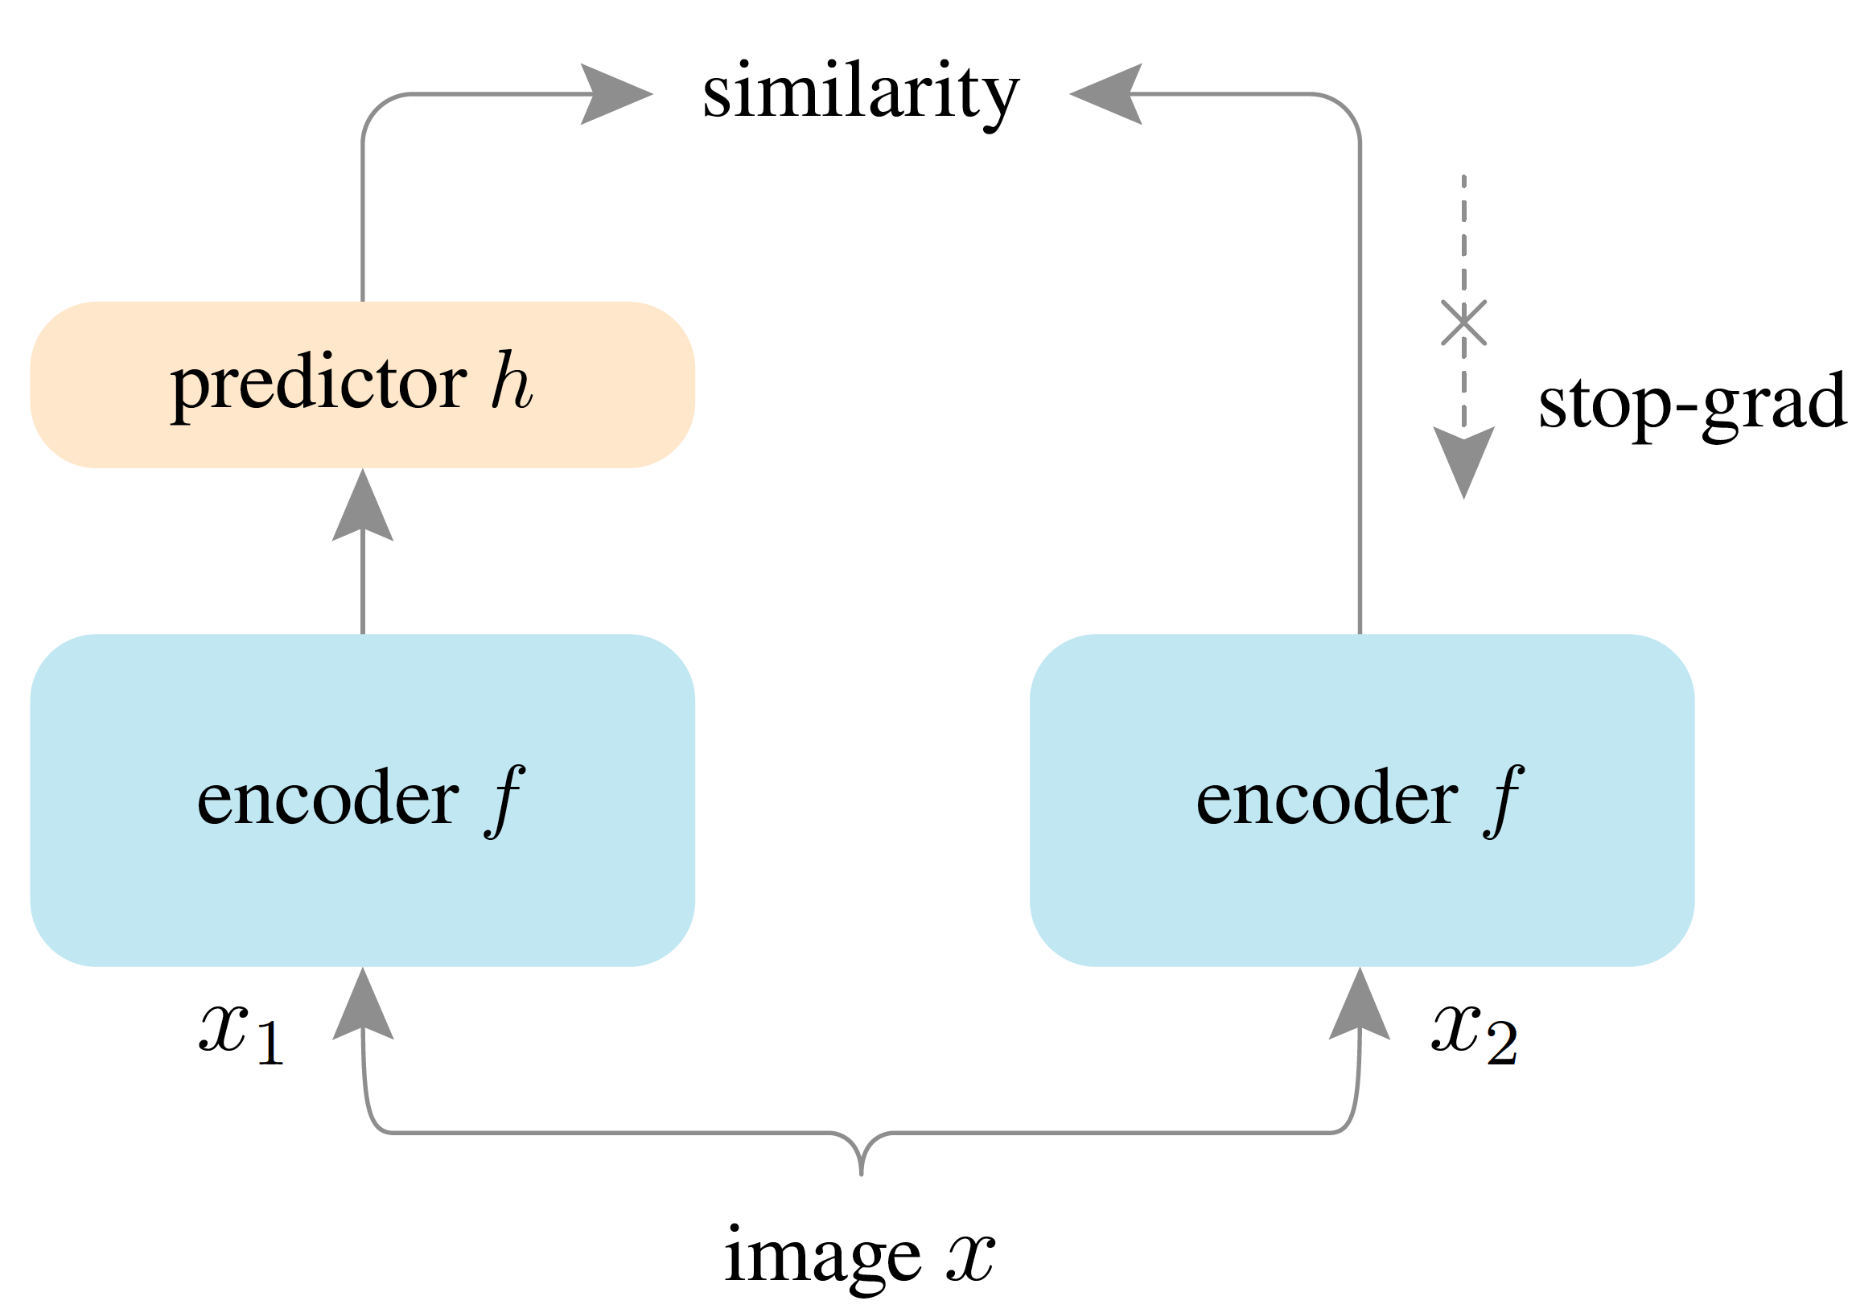
Quick Summary :
Current process is better than the baseline.
Autostop works with no noise on the image.
Pending task:
Reproduce Tian’s work( in progress )
Since simple substruction works, not sure whether it is necessary to find better strategy
Coding is not finished for simsiam and toy dataset .
Meeting Topics:
Agreement with Mission Statement.
Current Process about summer work and possible publishment.
Ideas about pushing BEng project forward.

Slide 2
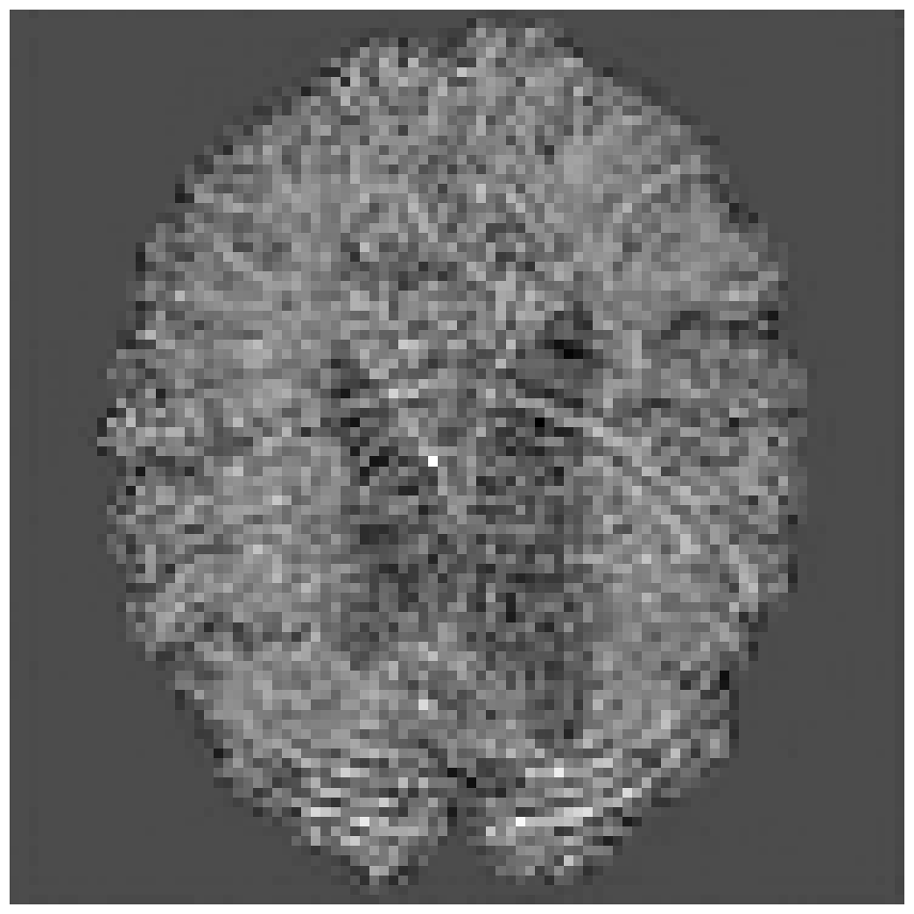
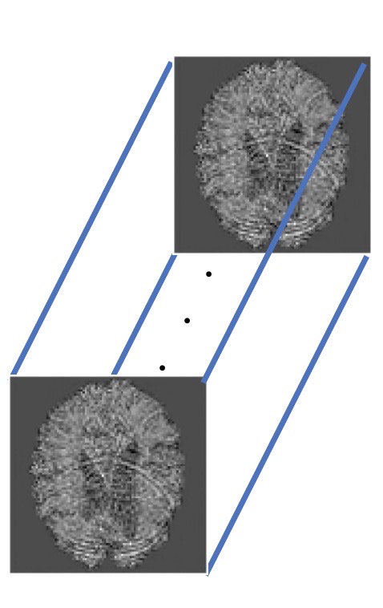
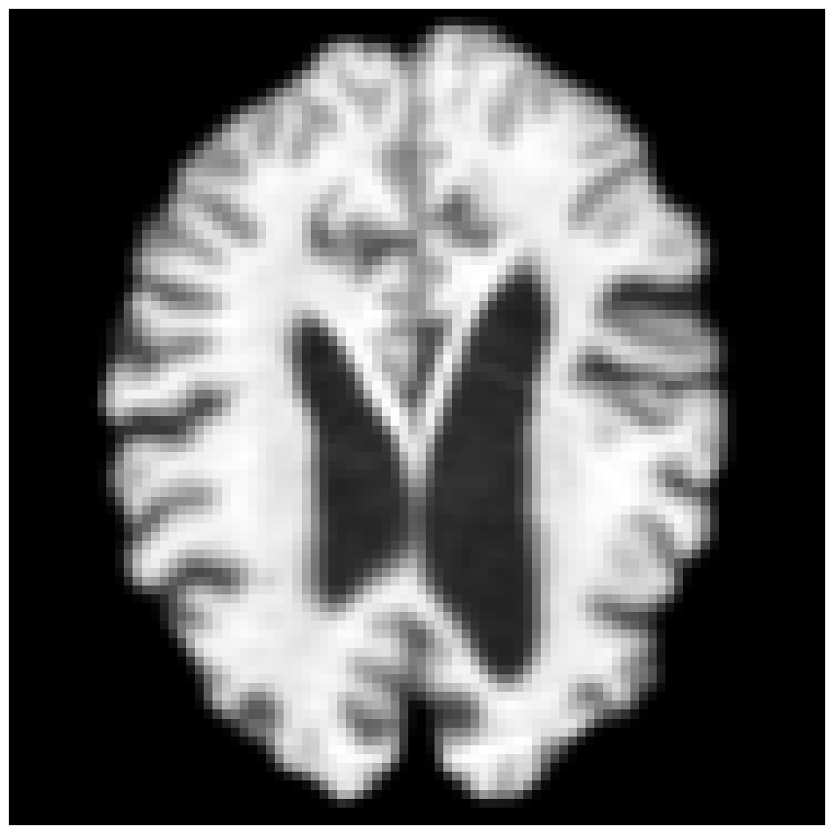
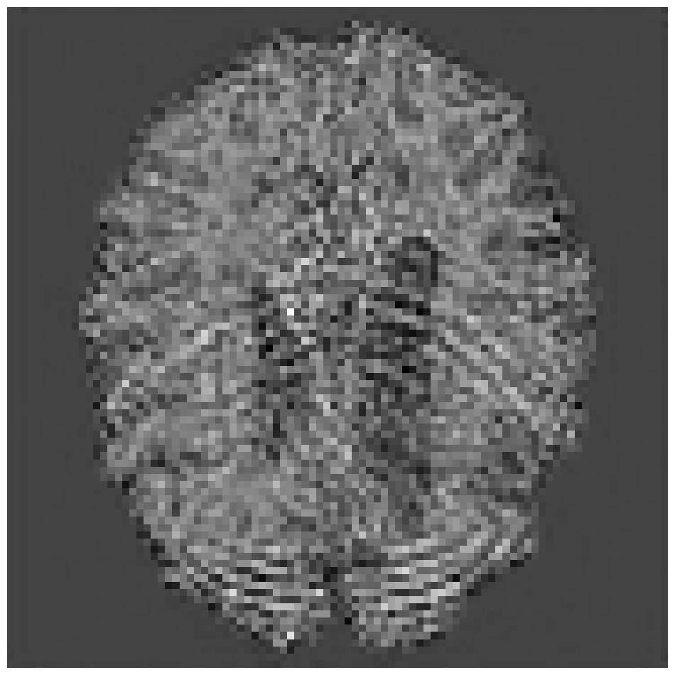
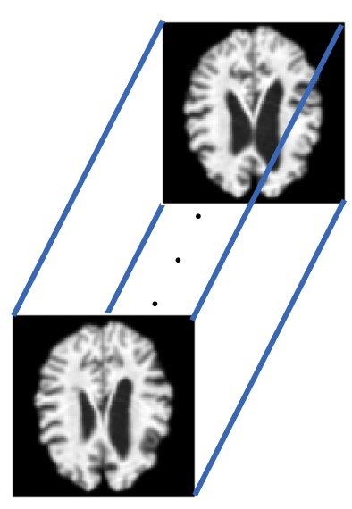
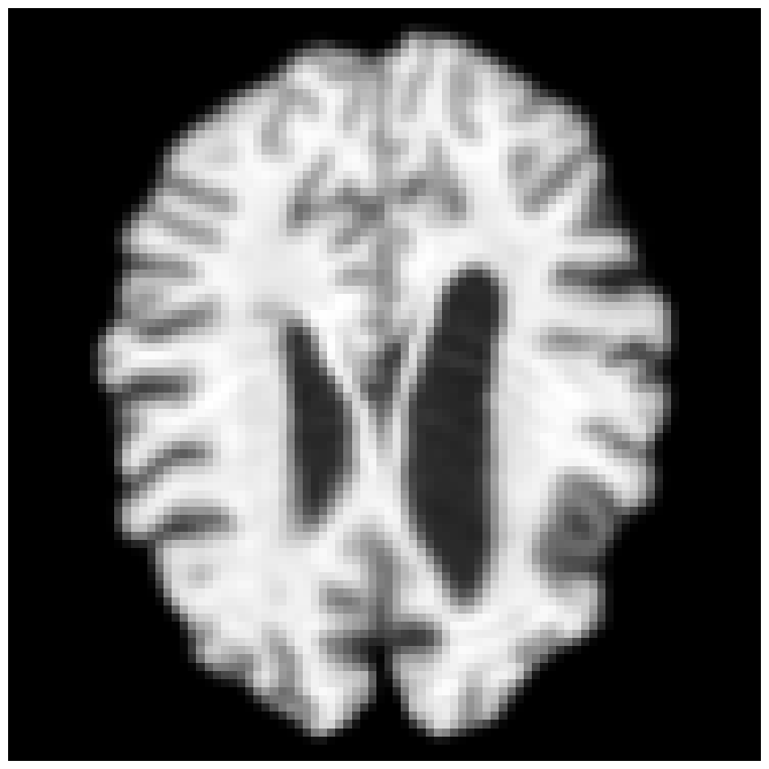

Slide 3
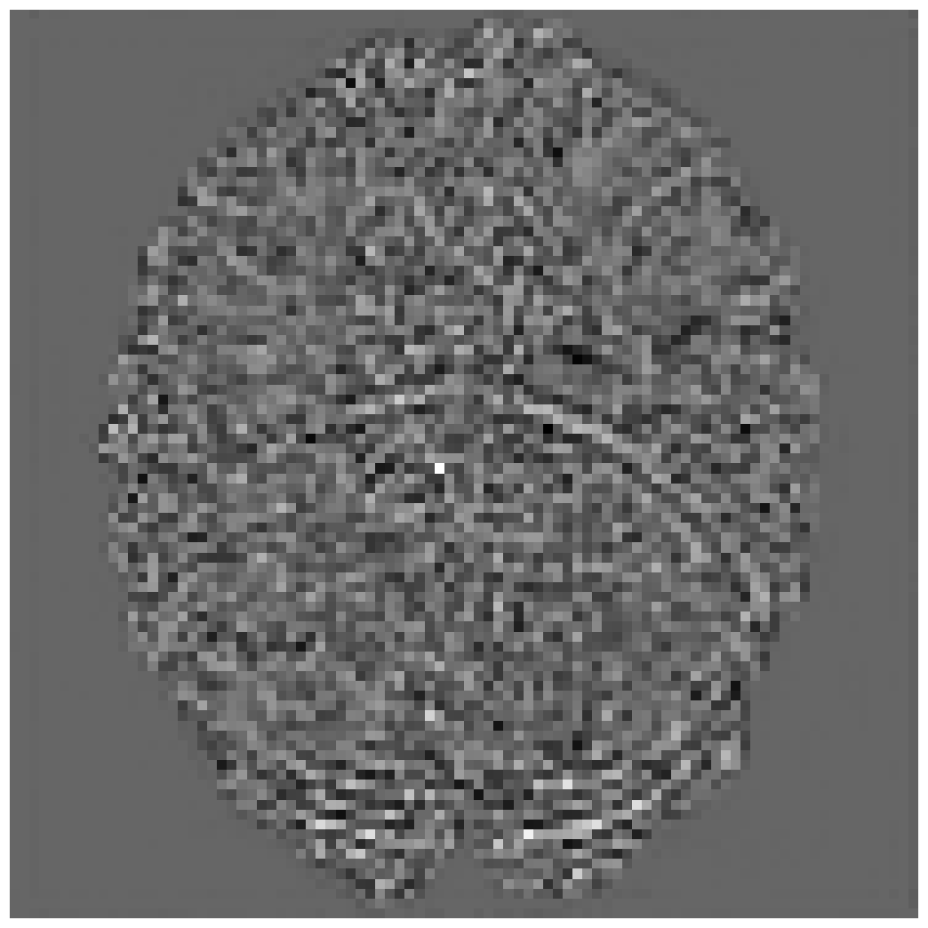



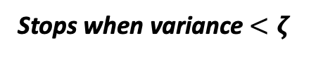
Abduction of Exogenous Noise Stage
Slices within a batch
Regressor
Variance among batch
Autostop
Stops when variance $<ζ$
❌
$$t=0$$
$$t=t_{0}$$
$$t=L ∗ T( 0<L≤1 )$$
Generation under Intervention

Slide 4
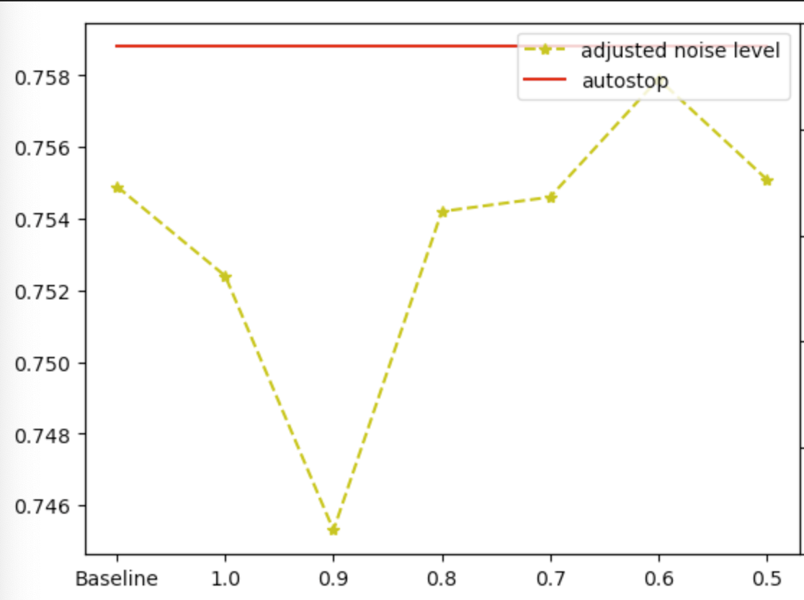
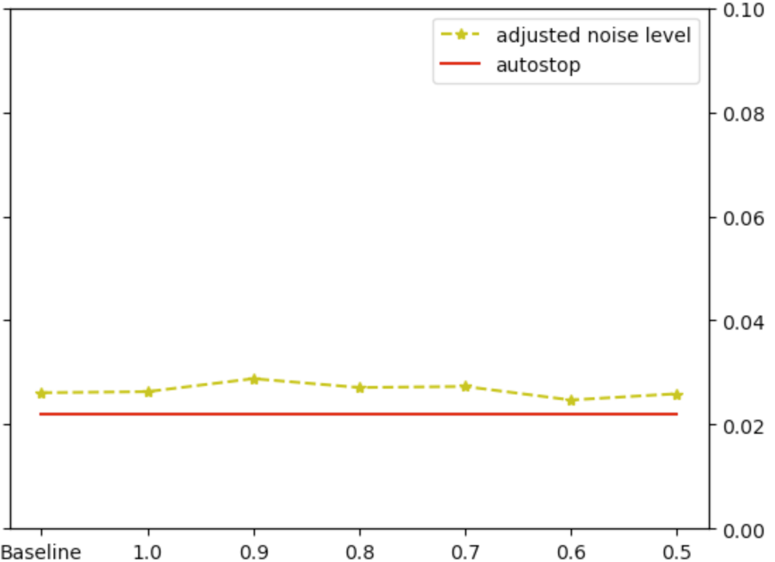


Reconstruction loss:
Simply apply difference reconstruction helps:
$X_{cf}−X_{r}$: 0.7830
Improve the performance about 3%
$X_{cf}$: 0.7756
Autostop mode helps to find optimal:
SSIM
MSE
Improve the performance about 10%
Next move:
Divide the experiments into 2 parts, ageing experiments for comparison, rejuvenation to show the effects
If time is sufficient, works on another dataset for classification task to provide stronger evidence for autostop.

Slide 5
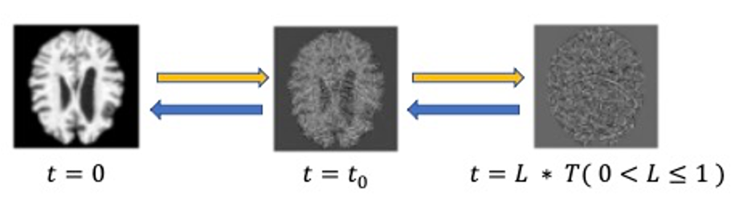
Observations

Slide 6
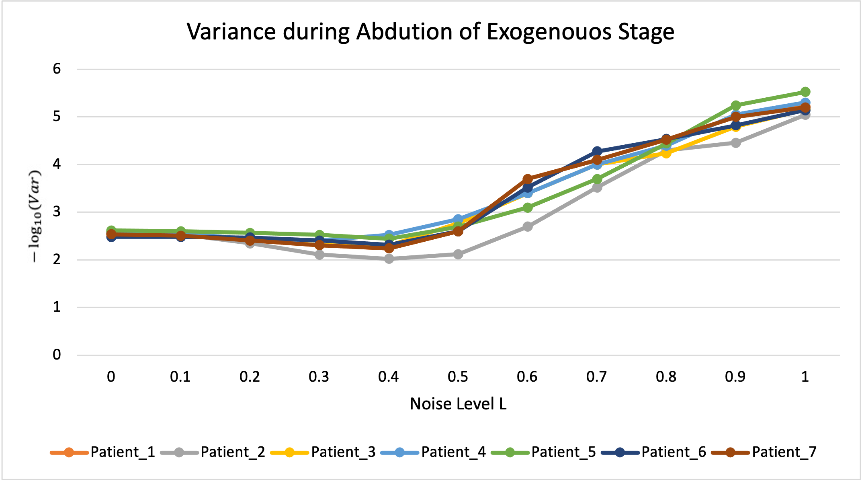
Observations
$−\log_{10}{Variance}$ during abduction of exogenous stage

Slide 7
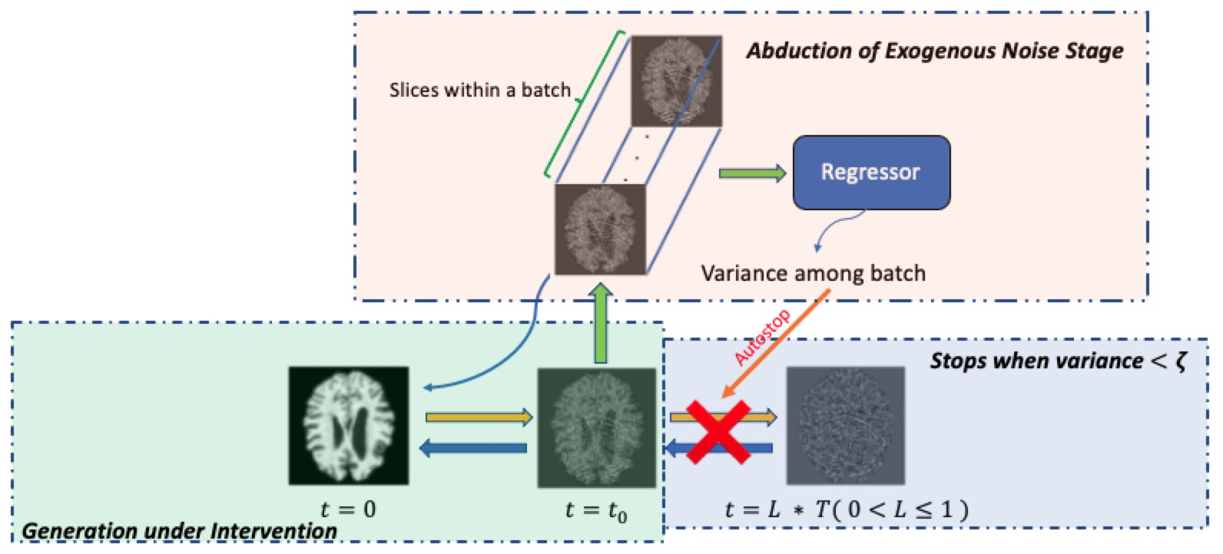
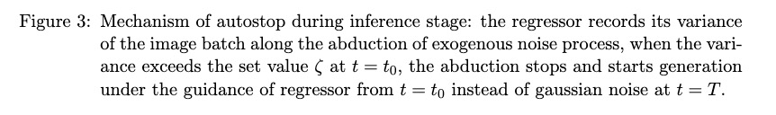
Mechanism

Slide 8
Few Concerns:
Generalization of method, I am confident though lacking of experiments
Relation between cross entropy and variance
The output also depends on timestep t. ( Verify quickly)

Slide 9
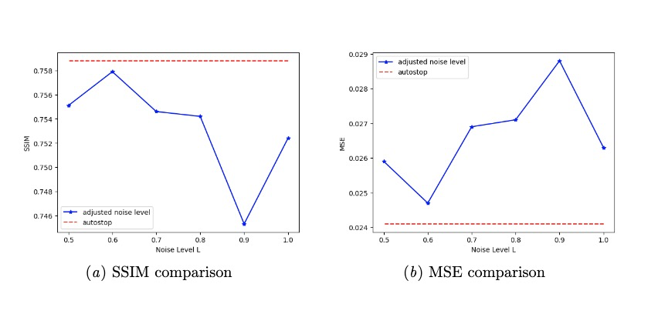
Effectiveness
Certain Individual:
Dataset Prospective:
Missing quantitively data because L < 0.5 is still running.
But it definitely works better than fixed L .

Slide 10
Brief Summary
What I’ve done:
Found the bug in counterfactual inference, the model training will finish today.
Started classifier-free guidance coding, and will finish by the end of this week.
Paper script

Slide 11
Worries about the method:
External guidance
Benefits:
Adapt to multi-task for different counterfactual tasks without re-training.
Drawbacks:
The external classifier cannot be joint training.
Counterfactuals might be counteracting.

Slide 12
Worries about the method
Classifier free:
Benefits:
Better performance.
Possible joint training to achieve the balance between identity preservation and counterfactual estimation.
Drawbacks:
Retraining for different task
Cost

Slide 13
Baseline for comparison
Bad performance:
Reproduction: 0.72 vs Org: 0.76 Try fine-tuning it or keep it?
Another Baseline( In construction )

Slide 14
Novelty and Impact
New method on ANDI -- Not a huge improvement with a single factor.
Optimal Noise Level Searching – A comprehensive method, however, other people now tend to use classifier-free.
Age measurement for comparison – Which one should I use? VGG-like network(Preferred) or current regressor trained on clean images?

Slide 15
Next Step…
Finish reproduction and renew the script.
Three methods for comparison.
Any suggestion? My thought is to try MIDL first, if it does not get accepted, then improve it with 3D-Brain.

Slide 16
Definition of the Problem
What we want: extract identity being invariant to age.

Slide 17

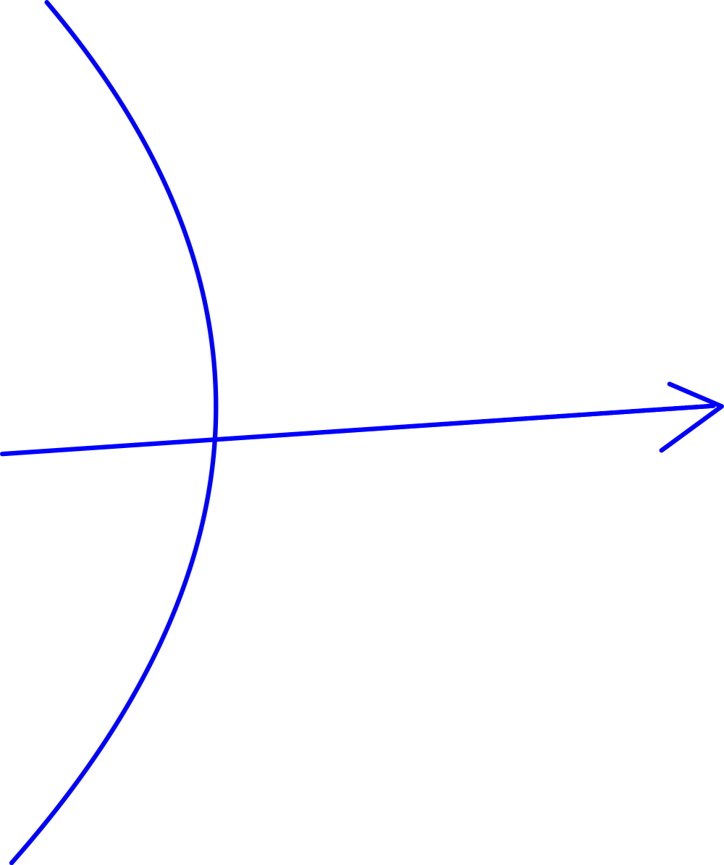







For patient_0, if we got…
feature extractor z=F(X)
$${age}_{0}$$
Question_1: how do we learn z and F to be unrelated to age
$$x_{0}$$
F(x)
Z, constant means it is related to identity but unrelated to age
$${age}_{1}$$
Feature_Extractor
learn a Y=D(z) that can extract identity being invariant to age
$$x_{1}$$
age = f_age(z)
$${age}_{2}$$
$$x_{2}$$
age = f_age()
$${\{x}_{i}\}$$

Slide 18
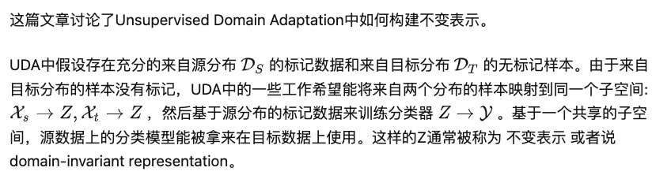
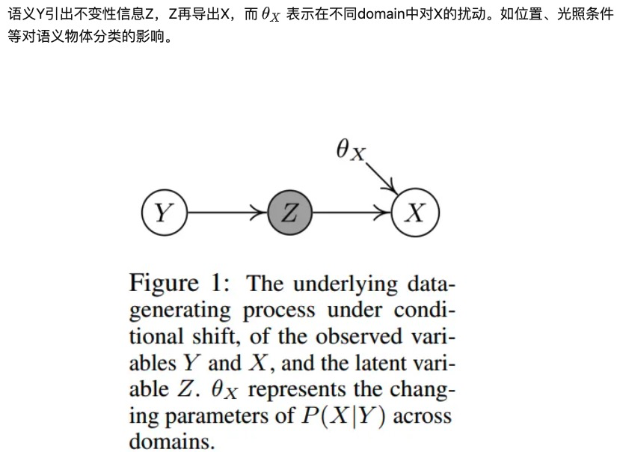
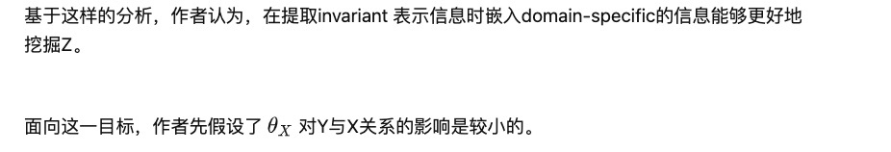

Slide 19
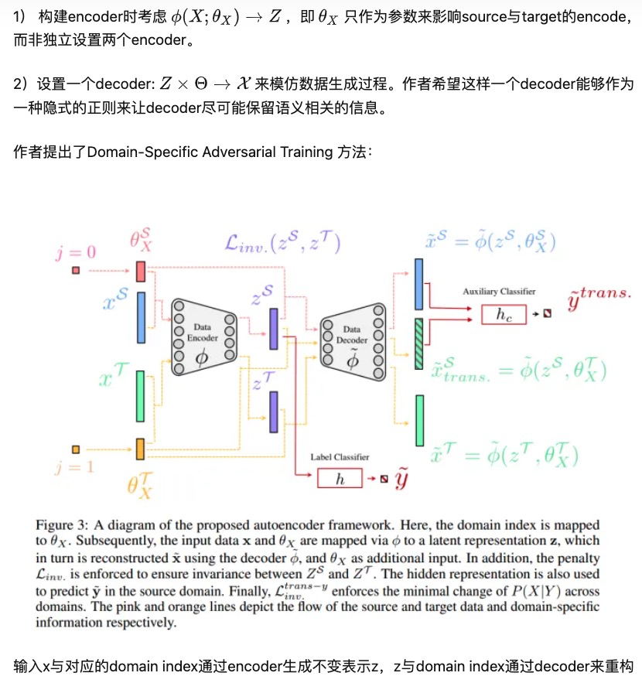

Slide 20
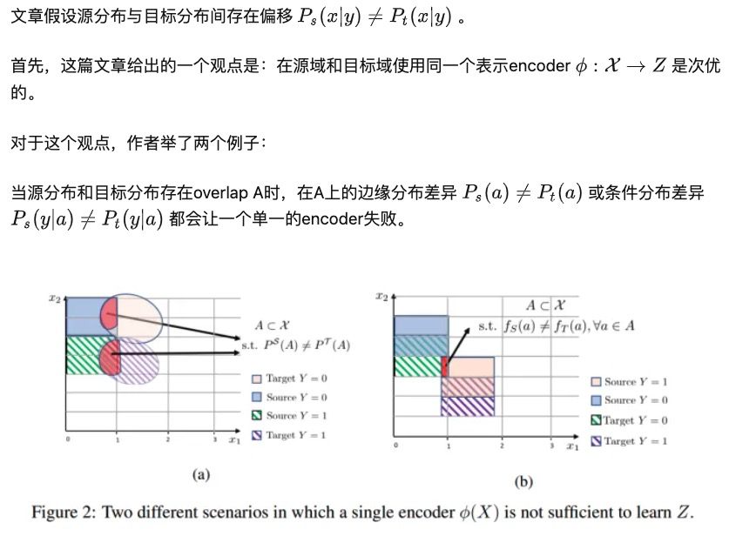

Slide 21
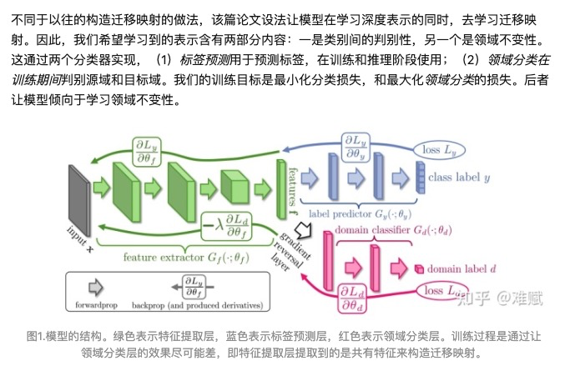



For N number of patients…
$$Identity:$$
$${\{I}_{i}\}$$
$$N$$

Slide 22
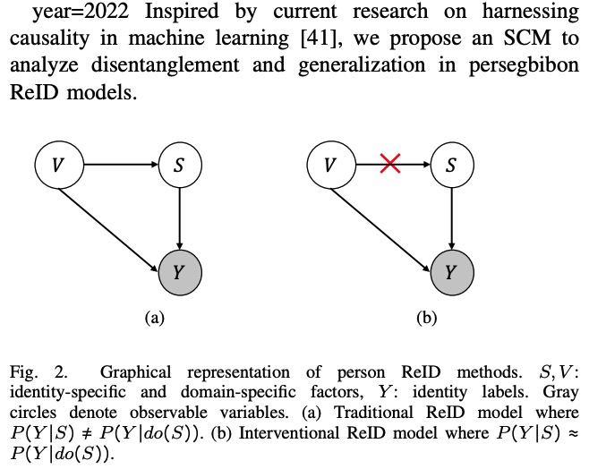
Domain-Invariant Mapping Network (DIMN)
is designed to learn a mapping between a person image and its identity classifier, i.e., it produces a classifier using a single shot.

Slide 23
